Slide 1

Scenarios
Will Usher
wusher@kth.se
MJ2380/MJ2381 – Introduction to Energy Systems Analysis and Applications
Lecture 4
2020-02-20
This work by OpTIMUS.community is licensed under the Creative Commons Attribution 4.0 International License. To view a copy of this license, visit http://creativecommons.org/licenses/by/4.0/.
Notes:
Presentation, title, me, Youssef
Contact info for any issue regarding the course
Emir situation – others like him? Write to me if so
All access to Canvas and read docs? Please do!!!
Please subscribe to a group – all - asap
If any issue re registration or so, come after lecture / write to me

Slide 2
Course overview
Introduction
Model development
Beyond the energy system
Scenario analysis
Applications
Lec1: Intro to Energy Systems Analysis and modelling tools
Lec2: Optimisation models and OSeMOSYS
Lec4: Normative, descriptive, explorative scenarios
Lec5: Energy systems analysis in real life
Lec3: Modelling aspects of CLEWs
Lab 1:
Basics of linear programming
Lab 3, 4 and 5:
Structuring a Simple Model
Lab 6:
Adding elements of CLEWs
Lab 2:
RES and temporal representation
PRO 1
PRO 2
PRO 3
PRO 4
PRO 5

Slide 3
Course overview
Introduction
Model development
Beyond the energy system
Scenario analysis
Applications
Lec1: Intro to Energy Systems Analysis and modelling tools
Lec2: Optimisation models and OSeMOSYS
Lec4: Normative, descriptive, explorative scenarios
Lec5: Energy systems analysis in real life
Lec3: Modelling aspects of CLEWs
Lab 1:
Basics of linear programming
Lab 3, 4 and 5:
Structuring a Simple Model
Lab 6:
Adding elements of CLEWs
Lab 2:
RES and temporal representation
PRO 1
PRO 2
PRO 3
PRO 4
PRO 5

Slide 4
Learning outcomes
At the end of this lecture, the student will be able to:
Put the scenario exercise of Lab 5 into context;
Distinguish between types of scenarios;
Have a solid general view of the steps usually required to carry out a complete scenario exercise;
Cite key literature of scenario analysis.
Notes:
Backcasting
Forecasting
Predictive/Exporative/Normative

Slide 5
Throughout the course
Please read carefully the following documents on Canvas
MJ2380/MJ2381 - Course description deliverables and grading
MJ2380/MJ2381 - Course schedule
MJ2380 - Project description (as soon as out)
Please keep the Canvas notifications on
If after having done (1) and (2) you still have questions, please contact:
Francesco Gardumi – gardumi@kth.se

Slide 6
Your feedback is important
Right after each lecture, there will be a quick evaluation on Canvas with only two subjects
Rate the lecture
Comment on the content and the lecturer
Notes:
We are far from perfect
Feedback is important: we are now applying also suggestions we received in MJ2413

Slide 7
Contents
Why do we use scenarios?
Scenario types and techniques
Creating a scenario
Examples of scenario exercises

Slide 8
Why do we use scenarios?

Slide 9
We do not know the future, but we can try and prepare for it.
Through scenarios we can:
Increase our understanding about the future;
Scan potential changes in the environment;
Build consensus for change;
Manage risks.
Maack J.N., Scenario Analysis: a Tool for Task Managers, 2001, World Bank

Slide 10
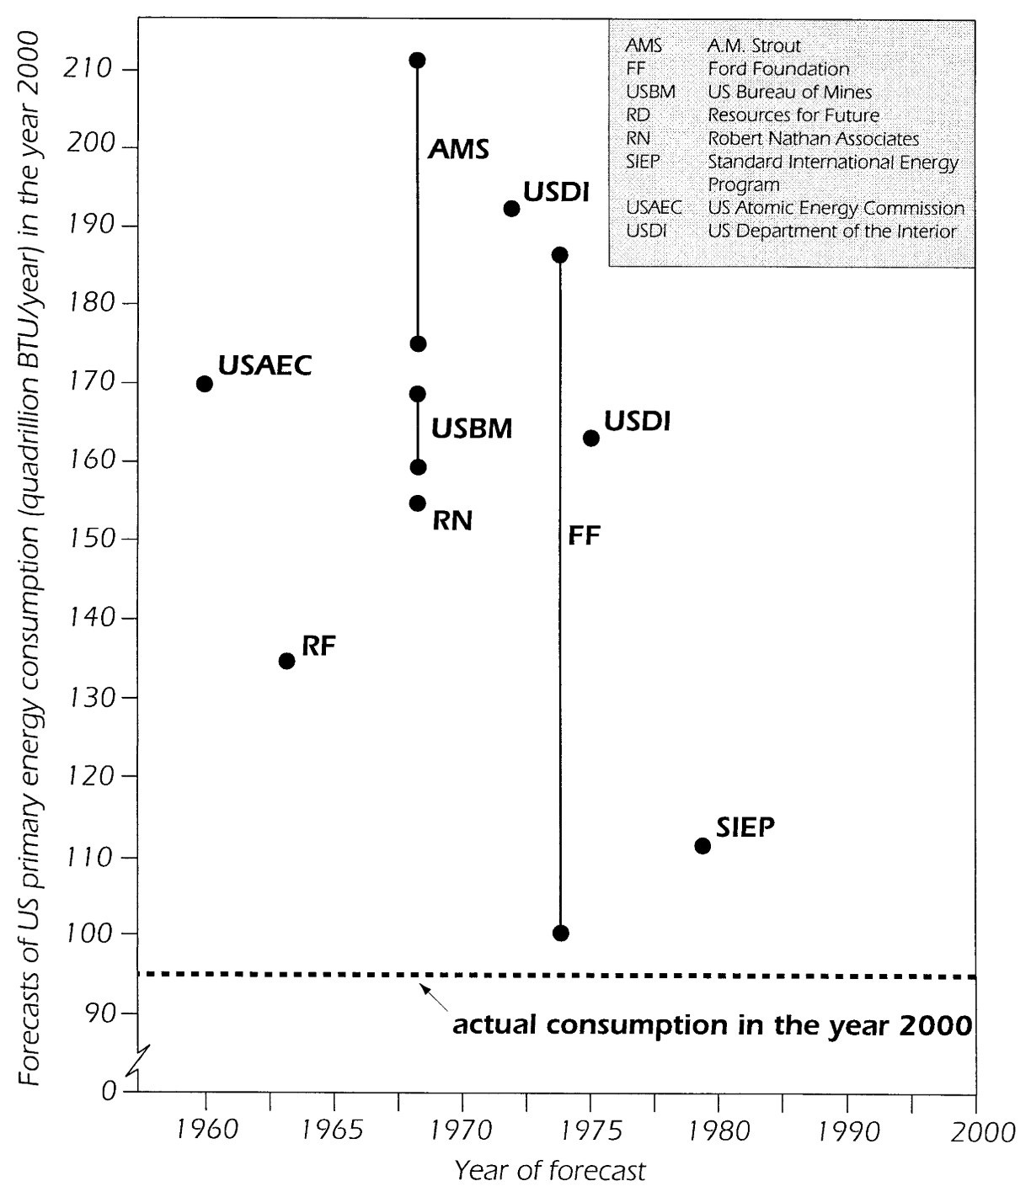
We do not know the future, but we can try and prepare for it.
Through scenarios we cannot predict the future!
﻿
Edison: “﻿I can therefore see no justification for the introduction of [AC current] which has no element of permanency and every element of danger to life and property”
Smil, V. (2000). Perils of Long-Range Energy Forecasting Reflections on Looking Far Ahead. Technological Forecasting and Social Change, 65(3), 251–264. https://doi.org/10.1016/S0040-1625(99)00097-9
Notes:
Technological optimism;

Slide 11
Introduction to scenarios: definition
Scenarios can represent both ‘descriptions of possible future states and descriptions of developments’.
Börjeson L. et al., Scenario types and techniques: Towards a user’s guide, Futures, 2006
They are more than model outputs or inputs. They narrate a whole story, with words and numbers;
They can encompass uncertain elements which are “actor contingent” (e.g. investments) and “non-actor contingent” (e.g. oil prices)
Hughes, N., Strachan, N., & Gross, R. (2012). The structure of uncertainty in future low carbon pathways. Energy Policy, 1–10. https://doi.org/10.1016/j.enpol.2012.04.028

Slide 12
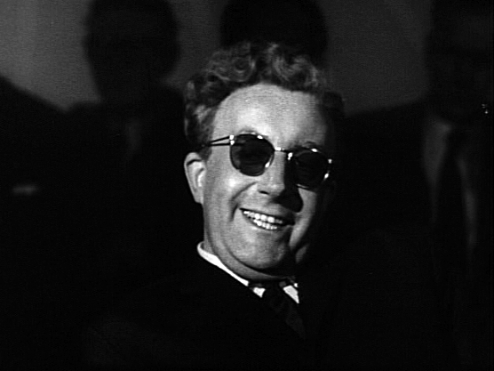
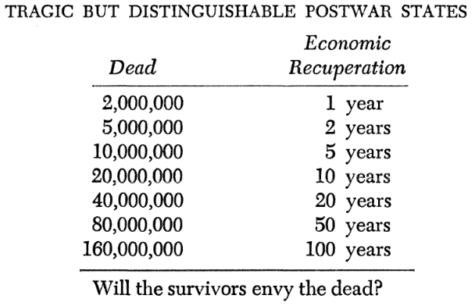
Use of scenarios
Use of scenarios in the modern era arose primarily as part of military strategy exercises.
Emergence of simulation models and subsequent evolution of “systems analysis” led to the adoption of scenario techniques - The Rand Corporation, USA.
The use of energy system models rose following the oil embargo in 1973; the practice of scenario planning rapidly grew during the same period.
By Directed by Stanley Kubrick, distributed by Columbia Pictures - Dr. Strangelove trailer from 40th Anniversary Special Edition DVD, 2004, Public Domain, https://commons.wikimedia.org/w/index.php?curid=11862639
Question! Why do you think scenario planning evolved then?
Kahn, H. (1960). On Thermonuclear War (2nd ed.). New Jersey: Princeton.
Notes:
Formalized use of scenarios in the modern era arose primarily as part of military strategy exercises that aimed at being prepared for different alternatives. The emergence of simulation models and the subsequent evolution of “systems analysis”, eventually led to the adoption of scenario techniques, many of which originate from work carried out by The Rand Corporation in the USA for defense oriented studies. The importance of scenario analysis increases when uncertainty and consequence increases. Just as the use of energy system models rose following the oil embargo in 1973, the practice of scenario planning rapidly grew during the same period

Slide 13
Use of scenarios – managing uncertainty
Scenario assessments encompass major uncertainties:
Iterative approach - technical, behavioral and financial feasibility can be assessed.
Scenario analysis can help in comprehending interrelation of key decision variables.
Formulation of insights to better understand implications of specific policy or investment decisions.
Robust or poor decisions can be identified.
Notes:
The assessment of a set of scenarios that are able to encompass the major uncertainties becomes imperative in energy systems analysis. An iterative approach can be adopted, in which the technical, behavioral and financial feasibility of the model outputs can be assessed sequentially in a range of scenarios. If carried out properly, scenario analysis can help in comprehending how the key decision variables interrelate and affect the system in question. At the same time, based on the outputs, the modeler can formulate insights and better understand the implications of specific policy or investment decisions. In this way, robust or poor decisions can be identified, for instance if they appear recurrently in all scenarios or in just one extreme scenario respectively.

Slide 14
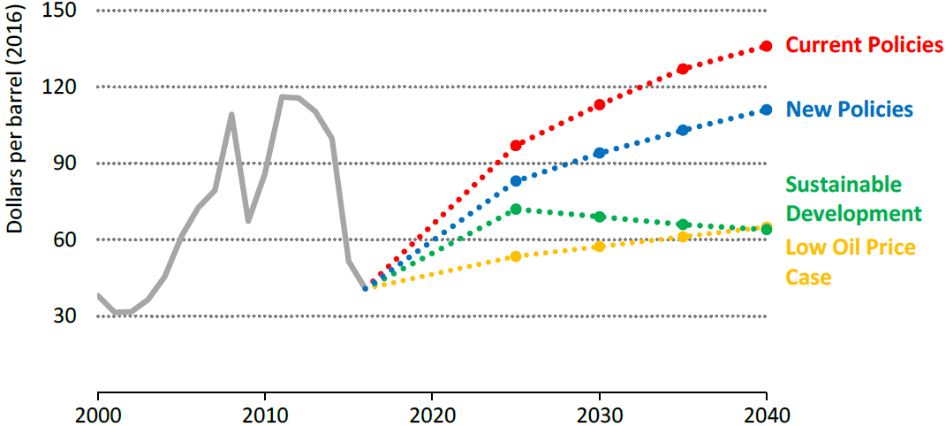
Uncertainty about external phenomena (Oil price)
Source: IEA WEO 2017
Notes:
Oil prices vary widely by scenario, reflecting the different ways in which resources, costs and policies could affect the supply-demand balance

Slide 15
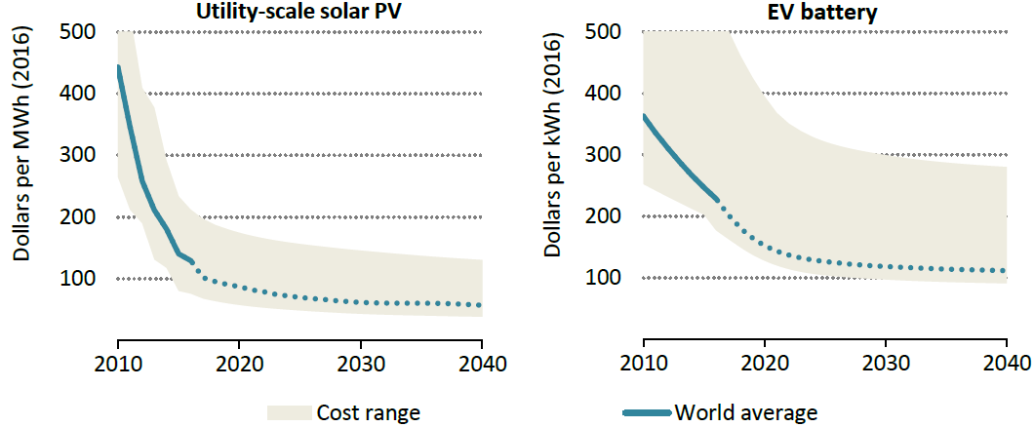
Uncertainty about external phenomena (solar photovoltaics and batteries)
Source: IEA WEO 2017
Notes:
Costs correspond to New Policies Scenario. Reductions in costs of key technologies continue to give strong impetus to the energy transition

Slide 16
Scenario types and techniques

Slide 17
Scenario types and techniques
No unique definition.
But three main types, based on the type of future they explore:
Probable – What will happen?
Possible – What can happen?
Preferable – How can a specific target be reached?

Slide 18
Scenario types and techniques
+ sensitivity analyses
Börjeson L. et al., Scenario types and techniques: Towards a user’s guide, Futures, 2006

Slide 19
Predictive scenarios
Used to assess and adapt to situations that are expected to occur. Typically useful to investors.
Two types:
Forecasts - What will happen, if the likely development unfolds?
What-if scenarios - What will happen, if some specified events occur?

Slide 20
Explorative scenarios
They aim to explore situations that are regarded as possible. IPCC climate change scenarios are of this kind.
Usually:
They are developed in a large number, to span a wide range of potential futures;
They look at a long-term horizon, to assess the impact of structural and deep changes.

Slide 21
Normative scenarios
They are used to assess how certain targets could be met and what it would take (in terms e.g. of investments).
Two types:
Preserving scenarios: how can a certain target be met, with adjustments to the current setting? (usually, cost-optimal ways are assessed, through optimisation frameworks);
Transforming scenarios: how can the target be met, provided the current setting prevents reaching it? (look at trend breaks, target-fulfilling images of the future; typically, backcasting techniques).

Slide 22
Sensitivity analyses
For all of these types of scenarios we may want to run sensitivity analyses:
i.e. Create new scenarios by changing the values of certain parameters, to span ranges of uncertainty.

Slide 23
Scenario types and techniques
Let us try and sort the scenarios of Lab 5 in these 3 categories...

Slide 24
Scenario 1: reduced wind availability
In the base case (which we will call Business As Usual – BAU – scenario), the availability of wind was considered constant throughout the seasons and across day and night.
By better observation of historical data for the location of wind farms in Simplicity, researchers have noticed that there actually is a difference of wind availability across seasons and between day and night. This reflects in different capacity factors for wind technologies. In summer time, capacity factors are as low as 12% during the night and 5% during the day. In the intermediate season, they are 10% and 20% in the night and day, respectively. In winter time, they become as high as 30% during the night and 15% during the day.

Slide 25
Scenario 1: reduced wind availability
In the base case (which we will call Business As Usual – BAU – scenario), the availability of wind was considered constant throughout the seasons and across day and night.
By better observation of historical data for the location of wind farms in Simplicity, researchers have noticed that there actually is a difference of wind availability across seasons and between day and night. This reflects in different capacity factors for wind technologies. In summer time, capacity factors are as low as 12% during the night and 5% during the day. In the intermediate season, they are 10% and 20% in the night and day, respectively. In winter time, they become as high as 30% during the night and 15% during the day.
Predictive

Slide 26
Scenario 2: breakthrough in solar technologies
Huge investments in the production of solar PV technologies in China and India and new trade agreements with Simplicity result in an abrupt decrease of the technology supply price from 2023 on. The capital cost of solar PV panels without storage becomes 1100 $/kW in 2023 and then linearly decreases down to 800 $/kW in 2040. The capital cost of PV panels including storage becomes 1800 $/kW in 2023 and decreases to 1200 $/kW in 2040.
Additionally, technological advancements make so that the capacity factors of solar PV in day time increase significantly, to 40% regardless the season.

Slide 27
Scenario 2: breakthrough in solar technologies
Huge investments in the production of solar PV technologies in China and India and new trade agreements with Simplicity result in an abrupt decrease of the technology supply price from 2023 on. The capital cost of solar PV panels without storage becomes 1100 $/kW in 2023 and then linearly decreases down to 800 $/kW in 2040. The capital cost of PV panels including storage becomes 1800 $/kW in 2023 and decreases to 1200 $/kW in 2040.
Additionally, technological advancements make so that the capacity factors of solar PV in day time increase significantly, to 40% regardless the season.
Explorative

Slide 28
Scenario 3: Energy Efficiency targets
The Government of Simplicity decides to pursue sustainability goals for the energy sector primarily through demand-side measures. A target of 5% annual energy savings in final uses for users already connected to the network is imposed from 2022 to 2025. After that, it is increased to 7.5% up to 2030. It becomes 10% thereafter.

Slide 29
Scenario 3: Energy Efficiency targets
The Government of Simplicity decides to pursue sustainability goals for the energy sector primarily through demand-side measures. A target of 5% annual energy savings in final uses for users already connected to the network is imposed from 2022 to 2025. After that, it is increased to 7.5% up to 2030. It becomes 10% thereafter.
Normative

Slide 30
Scenario 4: heat and electricity from biomass
Simplicity has large biomass resources, coming primarily from forestry residues. The state-owned utility decides to evaluate the possibility of using biomass to meet part of the heating and electricity demand in the residential sector, through Combined Heat & Power (CHP) plants, starting 2023. The CHP plants shall be connected to the Transmission Grid.
The biomass would have a cost of 1.5 $/GJ.
The new CHP plants would have to meet an annual heat demand growing linearly from 0.4 PJ in 2023 to 1 PJ in 2040. The demand has a flat profile across seasons and day parts.

Slide 31
Scenario 4: heat and electricity from biomass
Simplicity has large biomass resources, coming primarily from forestry residues. The state-owned utility decides to evaluate the possibility of using biomass to meet part of the heating and electricity demand in the residential sector, through Combined Heat & Power (CHP) plants, starting 2023. The CHP plants shall be connected to the Transmission Grid.
The biomass would have a cost of 1.5 $/GJ.
The new CHP plants would have to meet an annual heat demand growing linearly from 0.4 PJ in 2023 to 1 PJ in 2040. The demand has a flat profile across seasons and day parts.
Explorative

Slide 32
Scenario 5: solar generation target
The Government of Simplicity decides to support the generation by solar power plants by imposing a target of generation by PV power plants (either with or without storage). The target increases from 5% of the final electricity supply for new connections in 2020 to 70% in 2040.

Slide 33
Scenario 5: solar generation target
The Government of Simplicity decides to support the generation by solar power plants by imposing a target of generation by PV power plants (either with or without storage). The target increases from 5% of the final electricity supply for new connections in 2020 to 70% in 2040.
Normative

Slide 34
Scenario 6: Climate change
By taking a close look at long-term historical data series of water flow in rivers across seasons, researchers find out that the flow is being significantly affected by climatic change. The Government acts right away by imposing that hydropower generation be reduced consequently from 2020 on, in order not to further affect the water ecosystem and not to reduce the availability of water for agricultural uses.
In summer, the maximum capacity factors of run of river power plants are reduced to 20%; in winter, to 30%; in the intermediate season, to 25%. The capacity of the River feeding the dam hydro power plants, instead, reduces to 30% in summer, 35% in the intermediate season and 40% in winter.

Slide 35
Scenario 6: Climate change
By taking a close look at long-term historical data series of water flow in rivers across seasons, researchers find out that the water flow is being significantly affected by climatic change. The Government acts right away by imposing that hydropower generation be reduced consequently from 2020 on, in order not to further affect the water ecosystem and not to reduce the availability of water for agricultural uses.
In summer, the maximum capacity factors of run of river power plants are reduced to 20%; in winter, to 30%; in the intermediate season, to 25%. The capacity of the River feeding the dam hydro power plants, instead, reduces to 30% in summer, 35% in the intermediate season and 40% in winter.
Normative

Slide 36
Scenario 7: Climate change with no adaptation
The plan presented in Scenario 6 does not work as expected. Investors are not able to invest quickly enough to replace the missing hydro generation. While the capacity factors reduce exactly like in the previous case, the total capacity of all power plant types does not change as compared to what OBTAINED from Scenario 1 (hint: constrain all capacities of power plants for all years to values of capacity obtained as results in Scenario 1).
Investigate whether it is still possible to meet the electricity demand in these conditions.

Slide 37
Scenario 7: Climate change with no adaptation
The plan presented in Scenario 6 does not work as expected. Investors are not able to invest quickly enough to replace the missing hydro generation. While the capacity factors reduce exactly like in the previous case, the total capacity of all power plant types does not change as compared to what OBTAINED from Scenario 1 (hint: constrain all capacities of power plants for all years to values of capacity obtained as results in Scenario 1).
Investigate whether it is still possible to meet the electricity demand in these conditions.
Explorative

Slide 38
Scenario 8: Climate change with no adaptation – import potential
A contingency plan to build a line for electricity import from a neighbouring country (operational from 2028) may reduce the stress caused in the previous scenario. The cost of imported electricity is expected to be constant and equal to 0.1 $/kWh. The investment costs are considered sunk costs in this situation and can be disregarded.

Slide 39
Scenario 8: Climate change with no adaptation – import potential
A contingency plan to build a line for electricity import from a neighbouring country (operational from 2028) may reduce the stress caused in the previous scenario. The cost of imported electricity is expected to be constant and equal to 0.1 $/kWh. The investment costs are considered sunk costs in this situation and can be disregarded.
Explorative

Slide 40
Scenario 9: Electrification of transport
Until 2025, in Simplicity all transportation feeds on fossil fuels. From 2025, however, the population starts becoming aware of the huge environmental impacts on fossil-fuel-fired transportation. This, combined with a strong decrease in the prices of electric vehicles, due to economies of scale in other countries, and with infrastructure investments by the Government, causes a new demand for electricity for EVs to arise gradually. Such demand is null in 2025 and becomes comparable to the sum of all other electricity demands in 2040.
This demand has a different profile from the one for electricity for other uses: the profile of the demand is flat across seasons, but 75% of it happens during the night (as the vehicles are connected to the network and recharged during the night).
The vechicles will feed on the grid for existing users, but it is expected that more investments in power generation will be needed to meet this demand.

Slide 41
Scenario 9: Electrification of transport
Until 2025, in Simplicity all transportation feeds on fossil fuels. From 2025, however, the population starts becoming aware of the huge environmental impacts on fossil-fuel-fired transportation. This, combined with a strong decrease in the prices of electric vehicles, due to economies of scale in other countries, and with infrastructure investments by the Government, causes a new demand for electricity for EVs to arise gradually. Such demand is null in 2025 and becomes comparable to the sum of all other electricity demands in 2040.
This demand has a different profile from the one for electricity for other uses: the profile of the demand is flat across seasons, but 75% of it happens during the night (as the vehicles are connected to the network and recharged during the night).
The vechicles will feed on the grid for existing users, but it is expected that more investments in power generation will be needed to meet this demand.
Explorative

Slide 42
Scenario 10: Movie scenario
Think of a movie where something happens which causes huge, disruptive changes in energy supply and/or demand, create a short story for it (like the ones of all previous slides) and model it.
Think about whether your movie scenario is predictive, explorative or normative...

Slide 43
Creating a scenario (in the modelling practice)

Slide 44
Creating a scenario

Slide 45
1. Define focal issue and identify key drivers
Usually done in workshops with experts and stakeholders.
Focal issue(s): key question(s) we want to answer.
Drivers: Social, Economic, Environmental, Political and Technological forces that will determine how the future plays out.

Slide 46
1. Define focal issue and identify key drivers
Example from the H2020 REEEM Project – Reference Scenario
Focal issue(s): key question(s) we want to answer.
What are the role and the [social, environmental, economic] impacts of technology in the transition pathways to a low-carbon and competitive EU energy system by 2050?

Slide 47
1. Define focal issue and identify key drivers
Example from the H2020 REEEM Project – Reference Scenario
Drivers: Social, Economic, Environmental, Political and Technological forces that will determine how the future plays out.

Slide 48
2. Write scenario plot
One paragraph story (also called narrative) of how the key drivers defined above may interact in this scenario and how the future may play out.
It may integrate a qualitative picture with key numbers, to facilitate the modellers.
E.g. Lab 5, Scenario 6 – Climate Change
By taking a close look at long-term historical data series of water flow in rivers across seasons, researchers find out that the water flow is being significantly affected by climatic change. The Government acts right away by imposing that hydropower generation be reduced consequently from 2020 on, in order not to further affect the water ecosystem and not to reduce the availability of water for agricultural uses.

Slide 49
3. Collect and integrate numerical inputs
The plot written in Step 2 is here turned into numbers, which are fed as inputs to models.
NB!
A plot is generic and can lead to many different sets of input assumptions;
This becomes even more complicated when many models are involved in the analysis;
The assumptions must be consistent between themselves and with the plot. Tools exist to make sure assumptions are consistent, e.g. cross-impacts balances
Weimer-Jehle, W. (2006). Cross-impact balances: A system-theoretical approach to cross-impact analysis. Technological Forecasting and Social Change, 73(4), 334–361. https://doi.org/10.1016/j.techfore.2005.06.005.

Slide 50
4. Collect key results and check consistency
Key results can be collected into Key Performance Indicators (KPIs): they give a quick picture of how the future may look like in each scenario.
E.g.:
Rate of consumers preference for technology x (Society)
Temperature and rainfall changes (Environment)
GDP and competitivity indexes (Economy)
Rate of public investments in new infrastructure (Policy)
Technology Readiness Level of technology x (Technology)

Slide 51
4. Collect key results and check consistency
The results should be in line with the general story told by the scenario plot.
If not, go back to Step 1 and iterate the process.

Slide 52



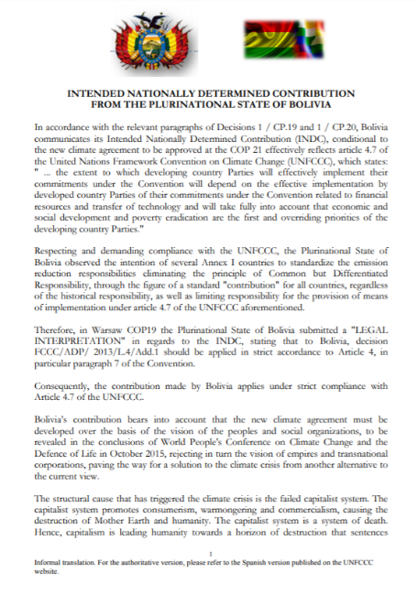
5. Disseminate and integrate into strategies
Disseminate through papers, reports, workshops, public events, media;
Disseminate in different ways for different audiences (researchers, civil society, investors, policy makers, …);
Document the whole process and be as open and transparent as possible.

Slide 53
Final recommendation
As modellers, when creating a scenario always remember:
Start with a question;
Include in your model the level of detail required to answer that question. Do not waste time in useless details and do not be too superficial.

Slide 54
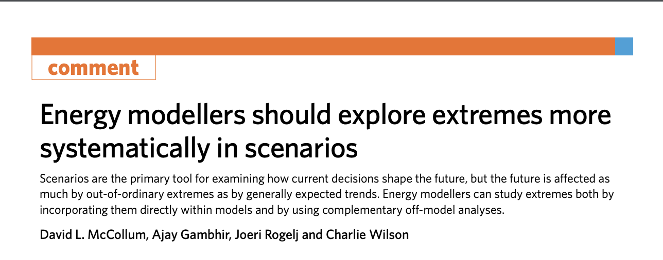
The trouble with scenarios - interpretation
“…I am familiar with the line that these are not forecasts but scenarios, intended only to show what happens under certain input assumptions. I reject it…if it looks like a forecast, swims like a forecast and quacks like a forecast, it is a forecast. It will be used to inform actual investment and policy decisions. And if that is not the intention, why publish it at all? Meanwhile, if your assumptions consistently produce bad results, make some new ones. Garbage out? Stop putting garbage in!”
Michael Liebreich https://about.bnef.com/blog/energy-transportation-stick-orthodoxy/

Slide 55
Examples of scenario exercises

Slide 56

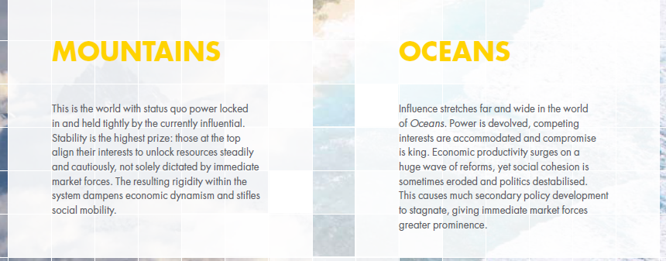
Examples of scenario exercises
Shell New Lens Scenarios – an example of corporate scenario design
Shell developed an early corporate lead in scenario planning
Wack, P. (1985). Scenarios: shooting the rapids. Harvard Business Review.
Wack, P. (1985). Scenarios: uncharted waters ahead. Harvard Business Review, 73–89.

Slide 57
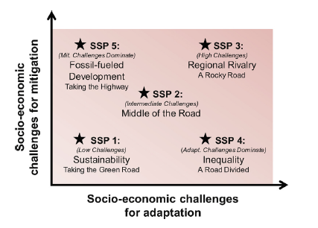
Examples of scenario exercises
Shared Socioeconomic Pathways (SSPs) – widely use by the research community
Set of scenarios developed by the Climate Change research community, describing future climate, societal and environmental change.
Using Integrated Assessment Models to fill these with quantitative insights.
https://www.climatescenarios.org/primer/
Source: O’ Neill B.C. et al, Global Environmental Change, 2015.

Slide 58
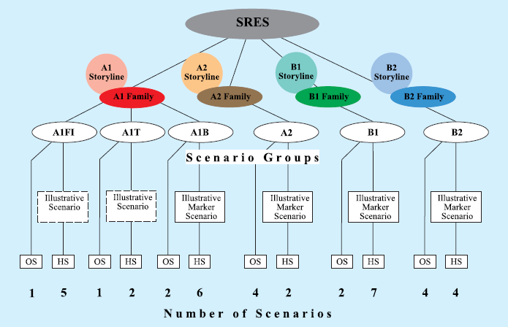
Examples of scenario exercises
IPCC Emission Scenarios
First developed in 1990.
Don’t take into account UNFCCC or Kyoto commitments.
Span large range of uncertainty on GHG emissions.
Source: IPCC Special Report: Emission Scenarios.

Slide 59
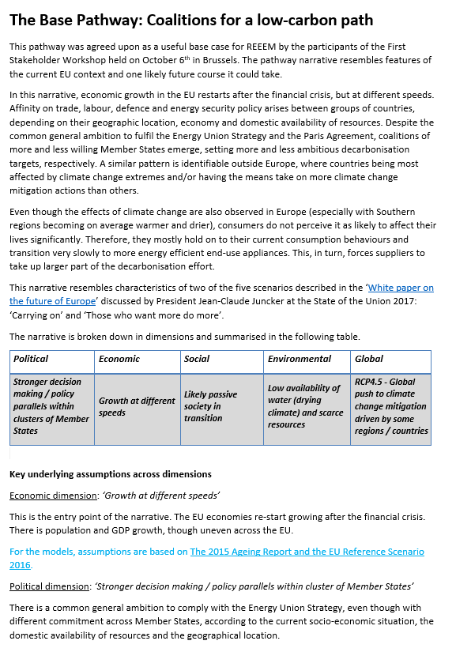
Examples of scenario exercises
H2020 REEEM Pathways
Three scenarios describing EU transition towards a low-carbon economy:
Base Pathway – no major disruptions
Local Solutions Pathway – society taking action
Paris Agreement Pathway – EU for a well below 1.5 C world

Slide 60
Key take away messages

Slide 61
Key take away messages
Scenarios help us look into how the future may play out so we can prepare and plan;
Scenarios are an important methodological tool for managing uncertainty
Scenario design is a structured process, carried out in several steps, potentially with iterations, and through interaction with stakeholders;
The creation of EVERY scenario starts with a question / focal issue; do not create useless scenarios for the sake of it!
There are three main types of scenarios: Predictive, Explorative and Normative.
Understand how the results and approach may be (mis-) interpreted

Slide 62
Reading material
J.N. Maack, Scenario Analysis: A Tool for Task Managers, 2001, World Bank: http://siteresources.worldbank.org/INTCDD/Resources/SAtools.pdf#page=68
L. Börjeson et al., Scenario types and techniques: Towards a user’s guide, 2006, Futures: https://www.sciencedirect.com/science/article/pii/S0016328705002132
H2020 REEEM Project, Report on pathway definition: http://www.reeem.org/wp-content/uploads/2017/09/REEEM-D1.1.pdf
P.J.H Schoemaker, When and How to Use Scenario Planning: A Heuristic Approach with Illustration, 1991, Journal of Forecasting: https://www.researchgate.net/publication/220040372_When_and_How_to_Use_Scenario_Planning_A_Heuristic_Approach_with_Illustration
Smil, V. (2000). Perils of Long-Range Energy Forecasting Reflections on Looking Far Ahead. Technological Forecasting and Social Change, 65(3), 251–264. https://doi.org/10.1016/S0040-1625(99)00097-9
Hughes, N., Strachan, N., & Gross, R. (2012). The structure of uncertainty in future low carbon pathways. Energy Policy, 1–10. https://doi.org/10.1016/j.enpol.2012.04.028

Slide 63
Thank you
For questions: wusher@kth.se

Slide 64
Changelog and Attribution
Date | Author | Reviewer | Reviser
2019-07-30 | Gardumi, F., Taliotis, C., Howells, M. | Howells, M. | Gardumi, F.
2020-02-17 |  |  | Usher, W.
To correctly reference this work, please use the following:
Gardumi, F., Taliotis, C., Howells, M., 2019. Scenarios, KTH-Desa and OpTIMUS.community.

